Slide 1
GitHub Copilot for SQL Development
Subhojit Basak
Product Manager, Azure Data
Notes:
Ladies and gentlemen,
Good morning / Good Evening and thank you for joining me today at the Future Data Driven Summit 2023. I am Subhojit Basak, and I have the privilege of serving as a Product Manager in Azure Data. Today, I am excited to delve into a topic that holds immense promise for SQL developers and data enthusiasts alike – "GitHub Copilot for SQL Development."
In the ever-evolving landscape of data-driven innovation, SQL continues to be a foundational language, powering countless applications and data solutions across the globe. As we gather here today, we find ourselves at a pivotal juncture in the world of SQL development. The tools at our disposal are advancing at a remarkable pace, empowering us to code more efficiently, collaboratively, and intelligently than ever before.
GitHub Copilot, a groundbreaking collaboration between GitHub and OpenAI, is a true embodiment of this transformation. It represents a leap forward in how we approach SQL development, bringing the power of artificial intelligence and machine learning to our fingertips. With GitHub Copilot, we have an AI-powered assistant that understands our code, anticipates our needs, and provides intelligent suggestions, drastically improving our productivity and code quality.

Slide 2
AGENDA
Overview
Getting Started with Copilot
Demos
Future Plans
Summary
Notes:
Now, let's embark on this journey together. Looking at the agenda today, I'll guide you through the fundamental aspects of GitHub Copilot for SQL Development, providing an overview that encompasses its capabilities, benefits, and real-world applications. We will explore how this remarkable tool can seamlessly integrate into your SQL development workflow, enhancing your experience and allowing you to unlock your full potential as a SQL developer.
I will also walk you through the steps to get started with GitHub Copilot, ensuring that you leave this session with the knowledge and tools needed to integrate it into your development environment. We'll see how Azure Data Studio, a powerful cross-platform database tool, can be the perfect companion for leveraging GitHub Copilot's capabilities effectively.
Moreover, I have some exciting demos lined up for you today. We'll witness GitHub Copilot in action, as it assists us in writing SQL queries, suggesting schema changes, and even generating complex joins. Through these practical examples, you will gain a firsthand understanding of how GitHub Copilot can streamline your SQL development tasks, saving you time and reducing the potential for errors.
But our journey doesn't end there. I will also share some glimpses of what the future holds for GitHub Copilot. We'll explore the evolving landscape of AI-driven SQL development and discuss how these innovations are reshaping the way we work with data.
Finally, we'll wrap up with a summary of the key takeaways from today's discussion. You will leave this session equipped with the knowledge and inspiration to harness the power of GitHub Copilot in your SQL development endeavors, ready to embrace a more efficient and collaborative future in data-driven software engineering.
So, without further ado, let's embark on this exciting exploration of GitHub Copilot for SQL Development. Together, we'll unveil the possibilities, break new ground, and embrace the future of data-driven innovation.

Slide 3

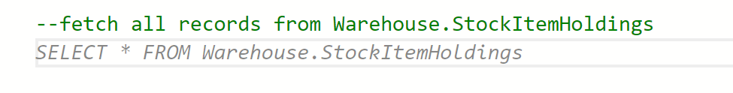

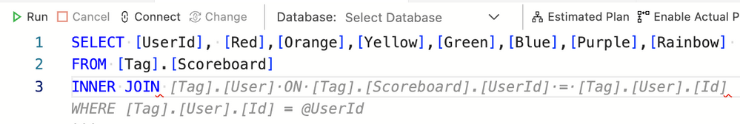



INTRODUCTION To
GitHub Copilot provides autocomplete-style suggestions from an AI pair programmer from within a developer’s IDE.
It takes natural language as input and gives back a snippet of code. How cool is that!
GitHub copilot comes as an extension with your favorite IDE. We have compatibility with all major IDE.
Notes:
Remember the time in our early coding days when we were told that we should write a comment before writing any piece of code, to define what that piece of code would signify?
With the use of Copilot, you are expected to write the comment, and copilot will give you the suggestion for the expected code that your comment signifies.
Stunning. Isn’t it!
Not just that! GitHub Copilot also provides you with auto-complete style suggestions to help you code faster and with more efficiency
Copilot comes as an extension to most of your favorite IDEs. Not just SQL, it can provide these suggestions for any programming language that is available over the internet

Slide 4

INTRODUCTION To
GitHub Copilot is your personal coding assistant
Notes:
GitHub Copilot can guide you whether you're learning to code, working in a new language or framework, or both. Eliminate the need to spend the majority of your time digging through documentation or conducting online searches to solve an issue or learn how to use a new framework.
Just imagine, how much time you can save when you don’t have to visit StackOverflow to search for a solution. It also saves you time to go to ChatGPT, type the code snippet and ask for suggestion.

Slide 5
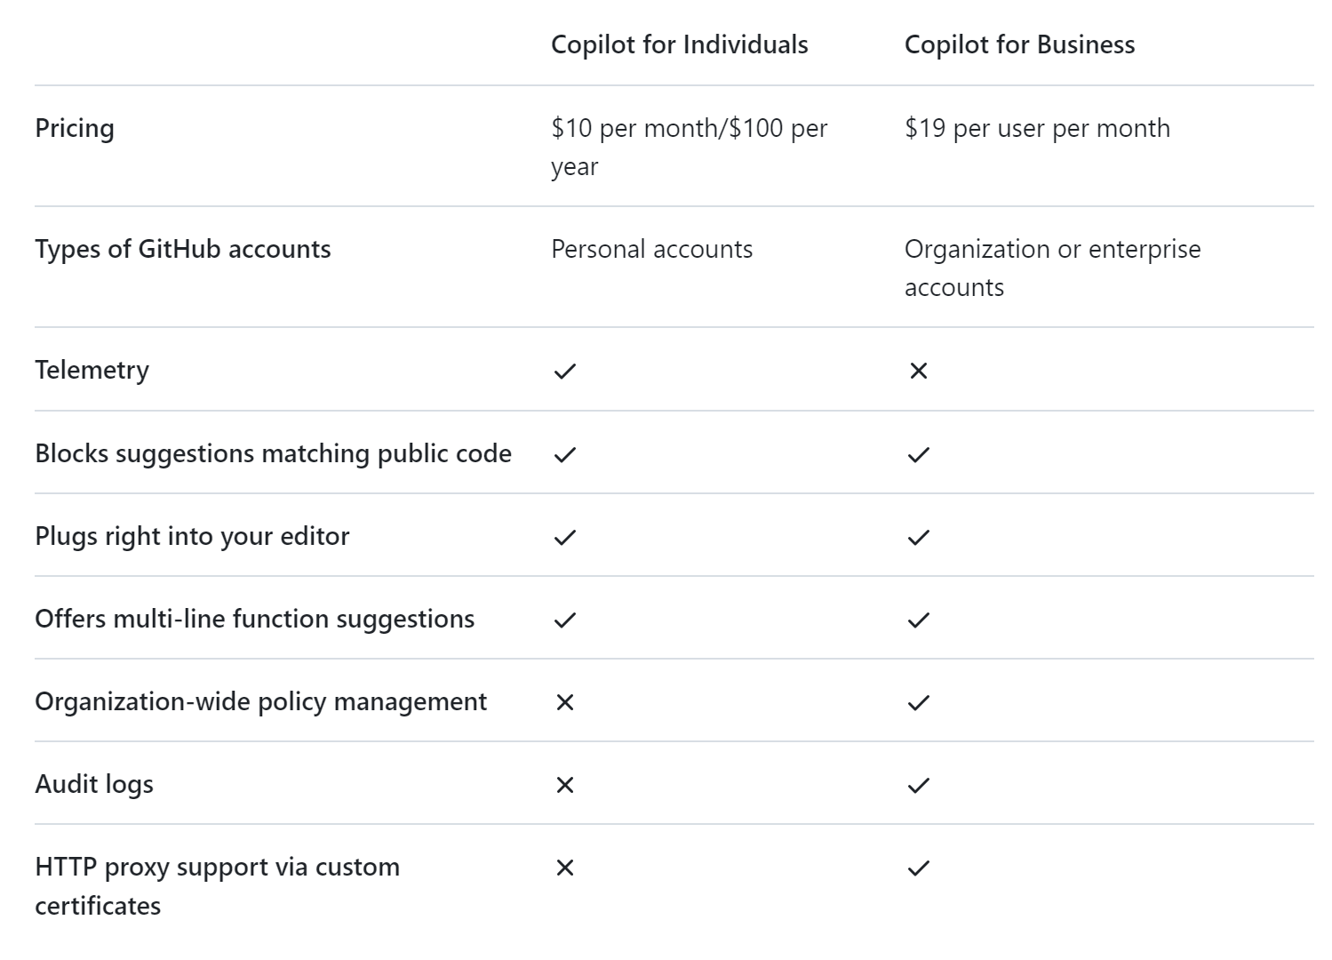
INTRODUCTION To
So how much does it cost??
Notes:
To use GitHub Copilot, you need to have a personal subscription ($10/month or $100/year), a business enterprise subscription ($19/user/month), or qualify for free (students, teachers, and maintainers of popular open-source repos).

Slide 6
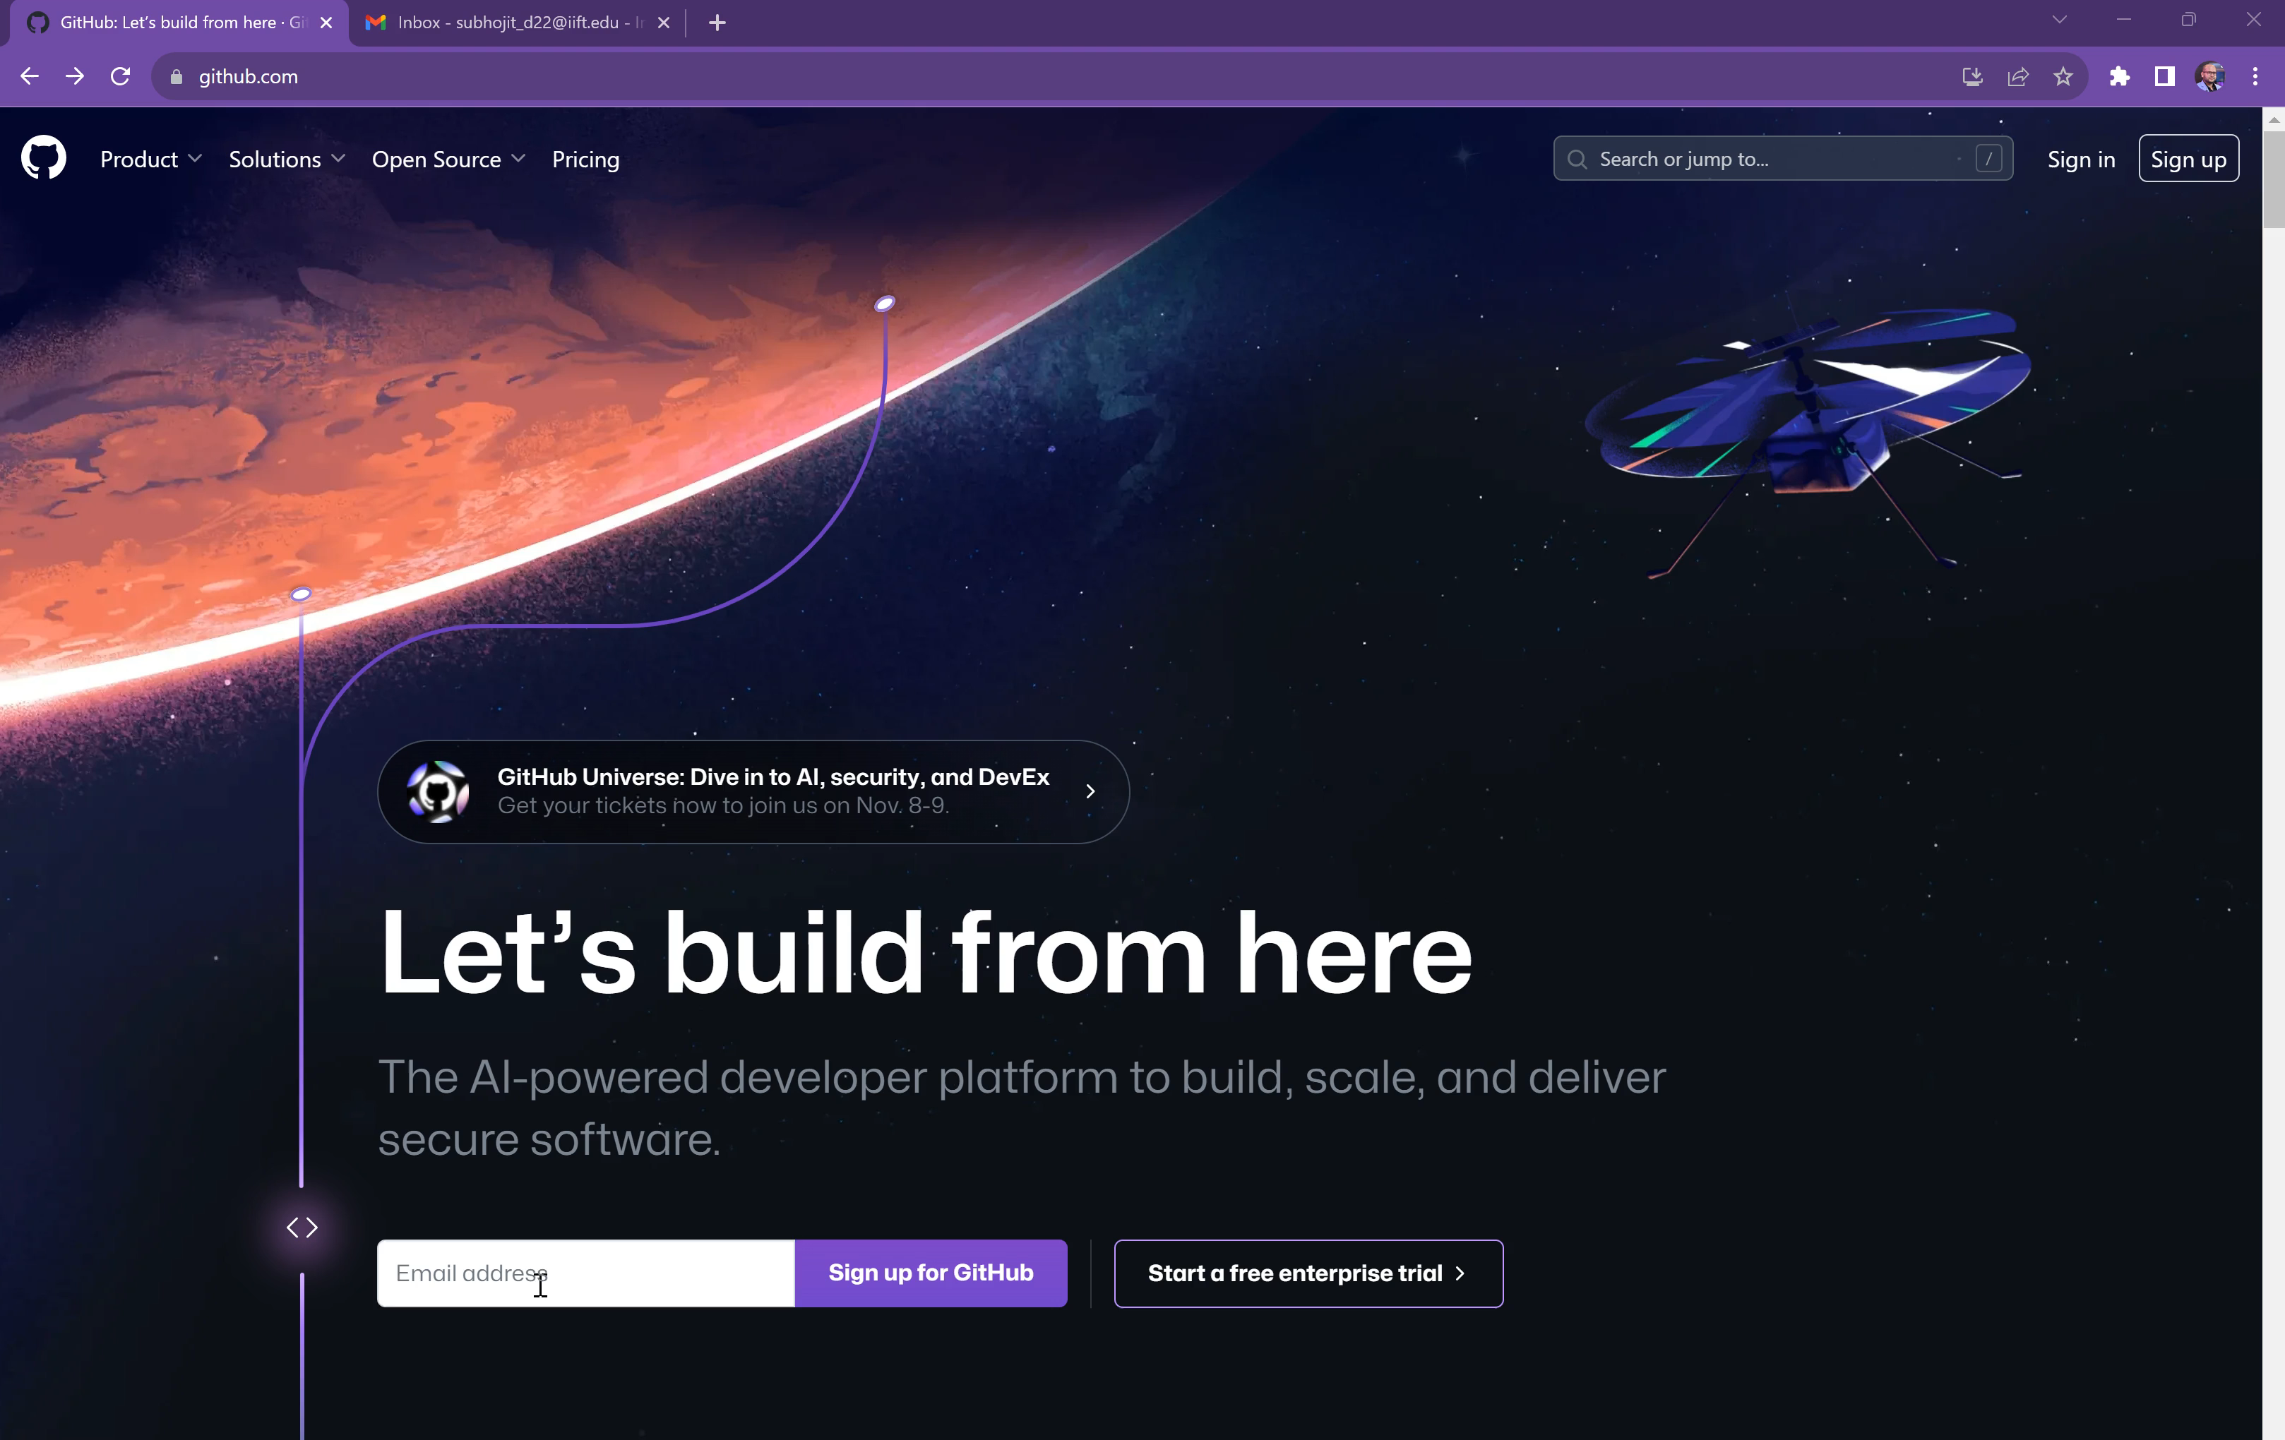

Getting Started with .
Pre-requisites
A GitHub Account
Subscription to a free trial of GitHub Copilot
Add GitHub Copilot as an extension in Visual Studio or VS Code or Azure Data Studio
Scan to create your own account
Notes:
I can totally understand that you are excited to learn more about GitHub Copilot. For the same, you need to have a GitHub Account. Scan the Red QR and it will take you to github.com I have a short video which I am going to play. It shows you from scratch how to create a GitHub Account, register for GitHub Copilot Trial version and get started. In case if this video is not visible to someone, I will find a way to share the contents which you can access at your own convenience.

Slide 7
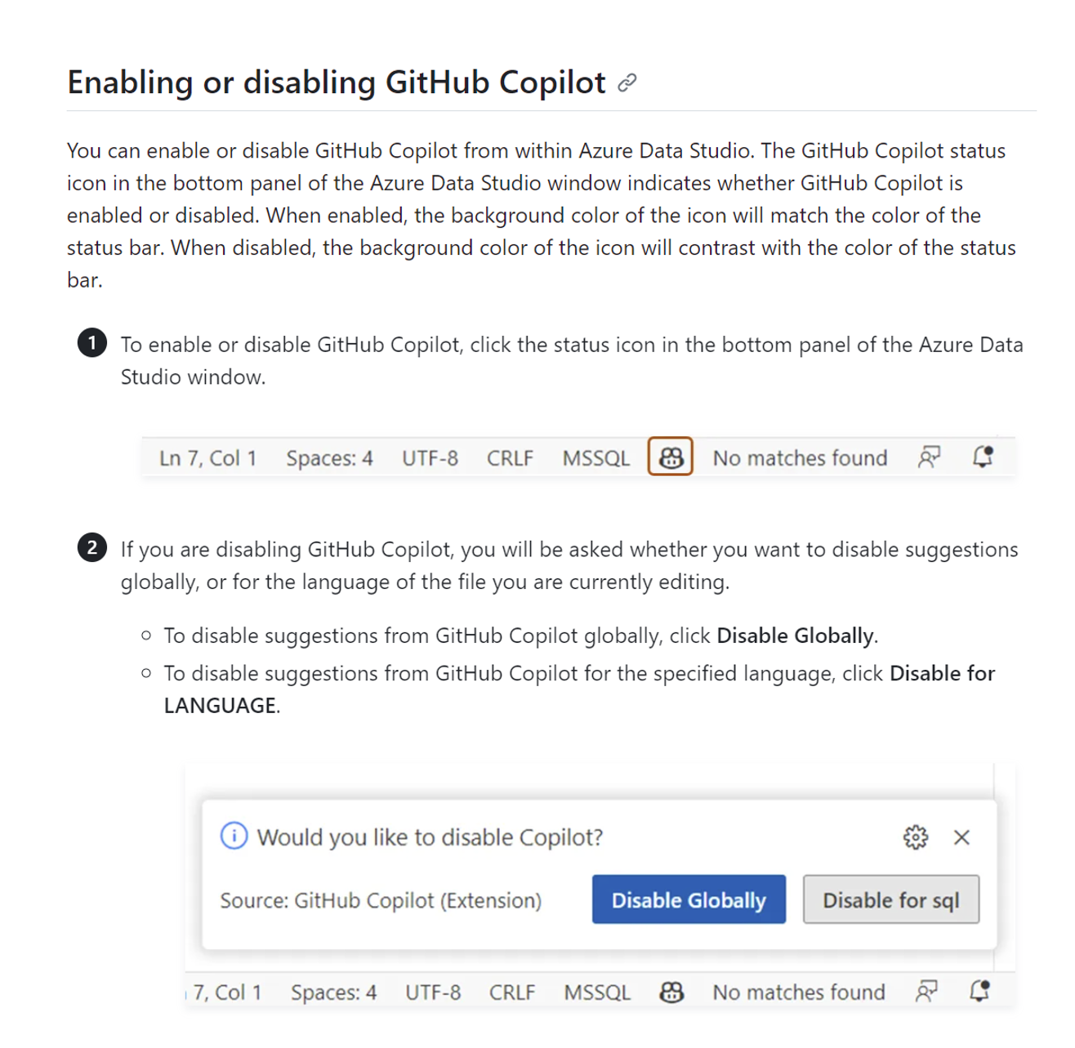
Getting Started with .
Once you have downloaded Azure Data Studio and installed the extension of GitHub Copilot, you must enable that extension.
Notes:
For the sake of our demos, I would be using Azure Data Studio and I will show you from where I can enable or disable GitHub Copilot.

Slide 8

WHAT DOES Capture?
Your data is safe.
We don’t store anything with us
We recommend and we forget
Notes:
A very obvious question that might come to your mind and I’m sure, some of you might have even asked me in the Questions QR, is that.. Oh god, you are providing suggestions on my code.. Are you spying on us? Can you see our code? Isn’t that a privacy concern!

Slide 9



How the Model works
Code Editor
Proxy
Model
PII
Toxicity
Code Classifier
Code Quality
Duplicate Detection
Notes:
Code Editor: Once the user writes a prompt in NL, it takes some code before the cursor and some codes after the cursor. This code is then transferred to the
Proxy Service: Lives in github owned azure tenet, where some basic sanitization happens where PII, hate speech are scraped off. We are also looking for code classifier.
It is this Proxy Service which tries to understand the language in which the prompt is expected to return the code in.
Every language that is supported in the public domain is supported In copilot
Model: We then pass this over to a Model, which is developed by Open ai (GPT 3.0), where this data is processed to generate the suggestion. It is only ever stored in transit long enough to present the suggestion, and encrypted all through. So we don't retain anything.
When we have the suggestion, we again bring it back to the Proxy. Here it again checks if the suggestion generated has some PII or some toxic info (hate speech) and add two new steps
Code Quality: check for common vulnerabilities like SQL injection, crossside scripting. If we find one, we will throw the code away, not show it to the customer and write another code.
Duplicate Detection: We don't want any org or businesses to worry that they have coincidentally or accidentally resembled code that is licensed in a way which is not coherent with the org policy
If the suggestion is over 150 characters, (big enough to matter), we will compare it against all the data in Github (billions of code) with a budget of 10-20 ms. If there is a match, we treat it like a security vulnerability. If a suggestion pass all the 5 parameters, only then do we show it as a suggestion.

Slide 10
Questions?

Slide 11
Demo 1: Simple Queries
Create, Select, Insert

Slide 12
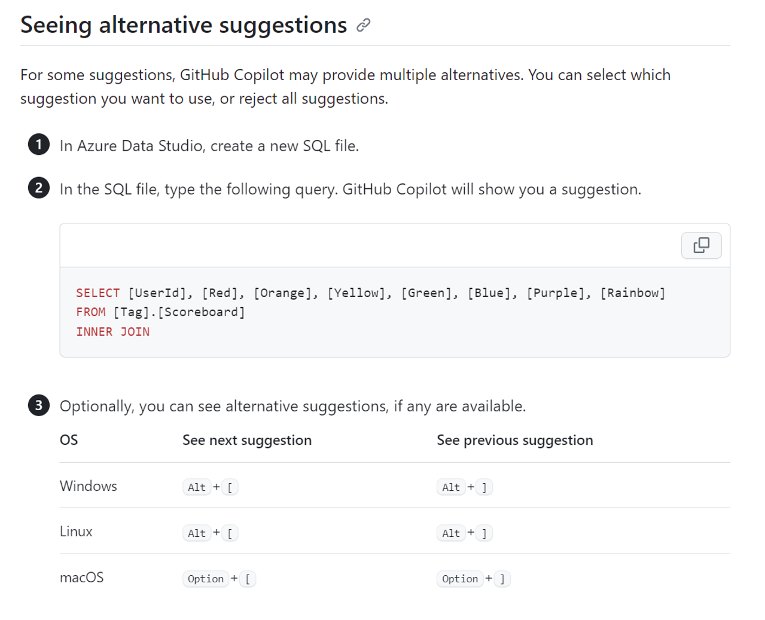
Getting Alternative Suggestions

Slide 13
Demo 2: Complex queries
Complex joins

Slide 14
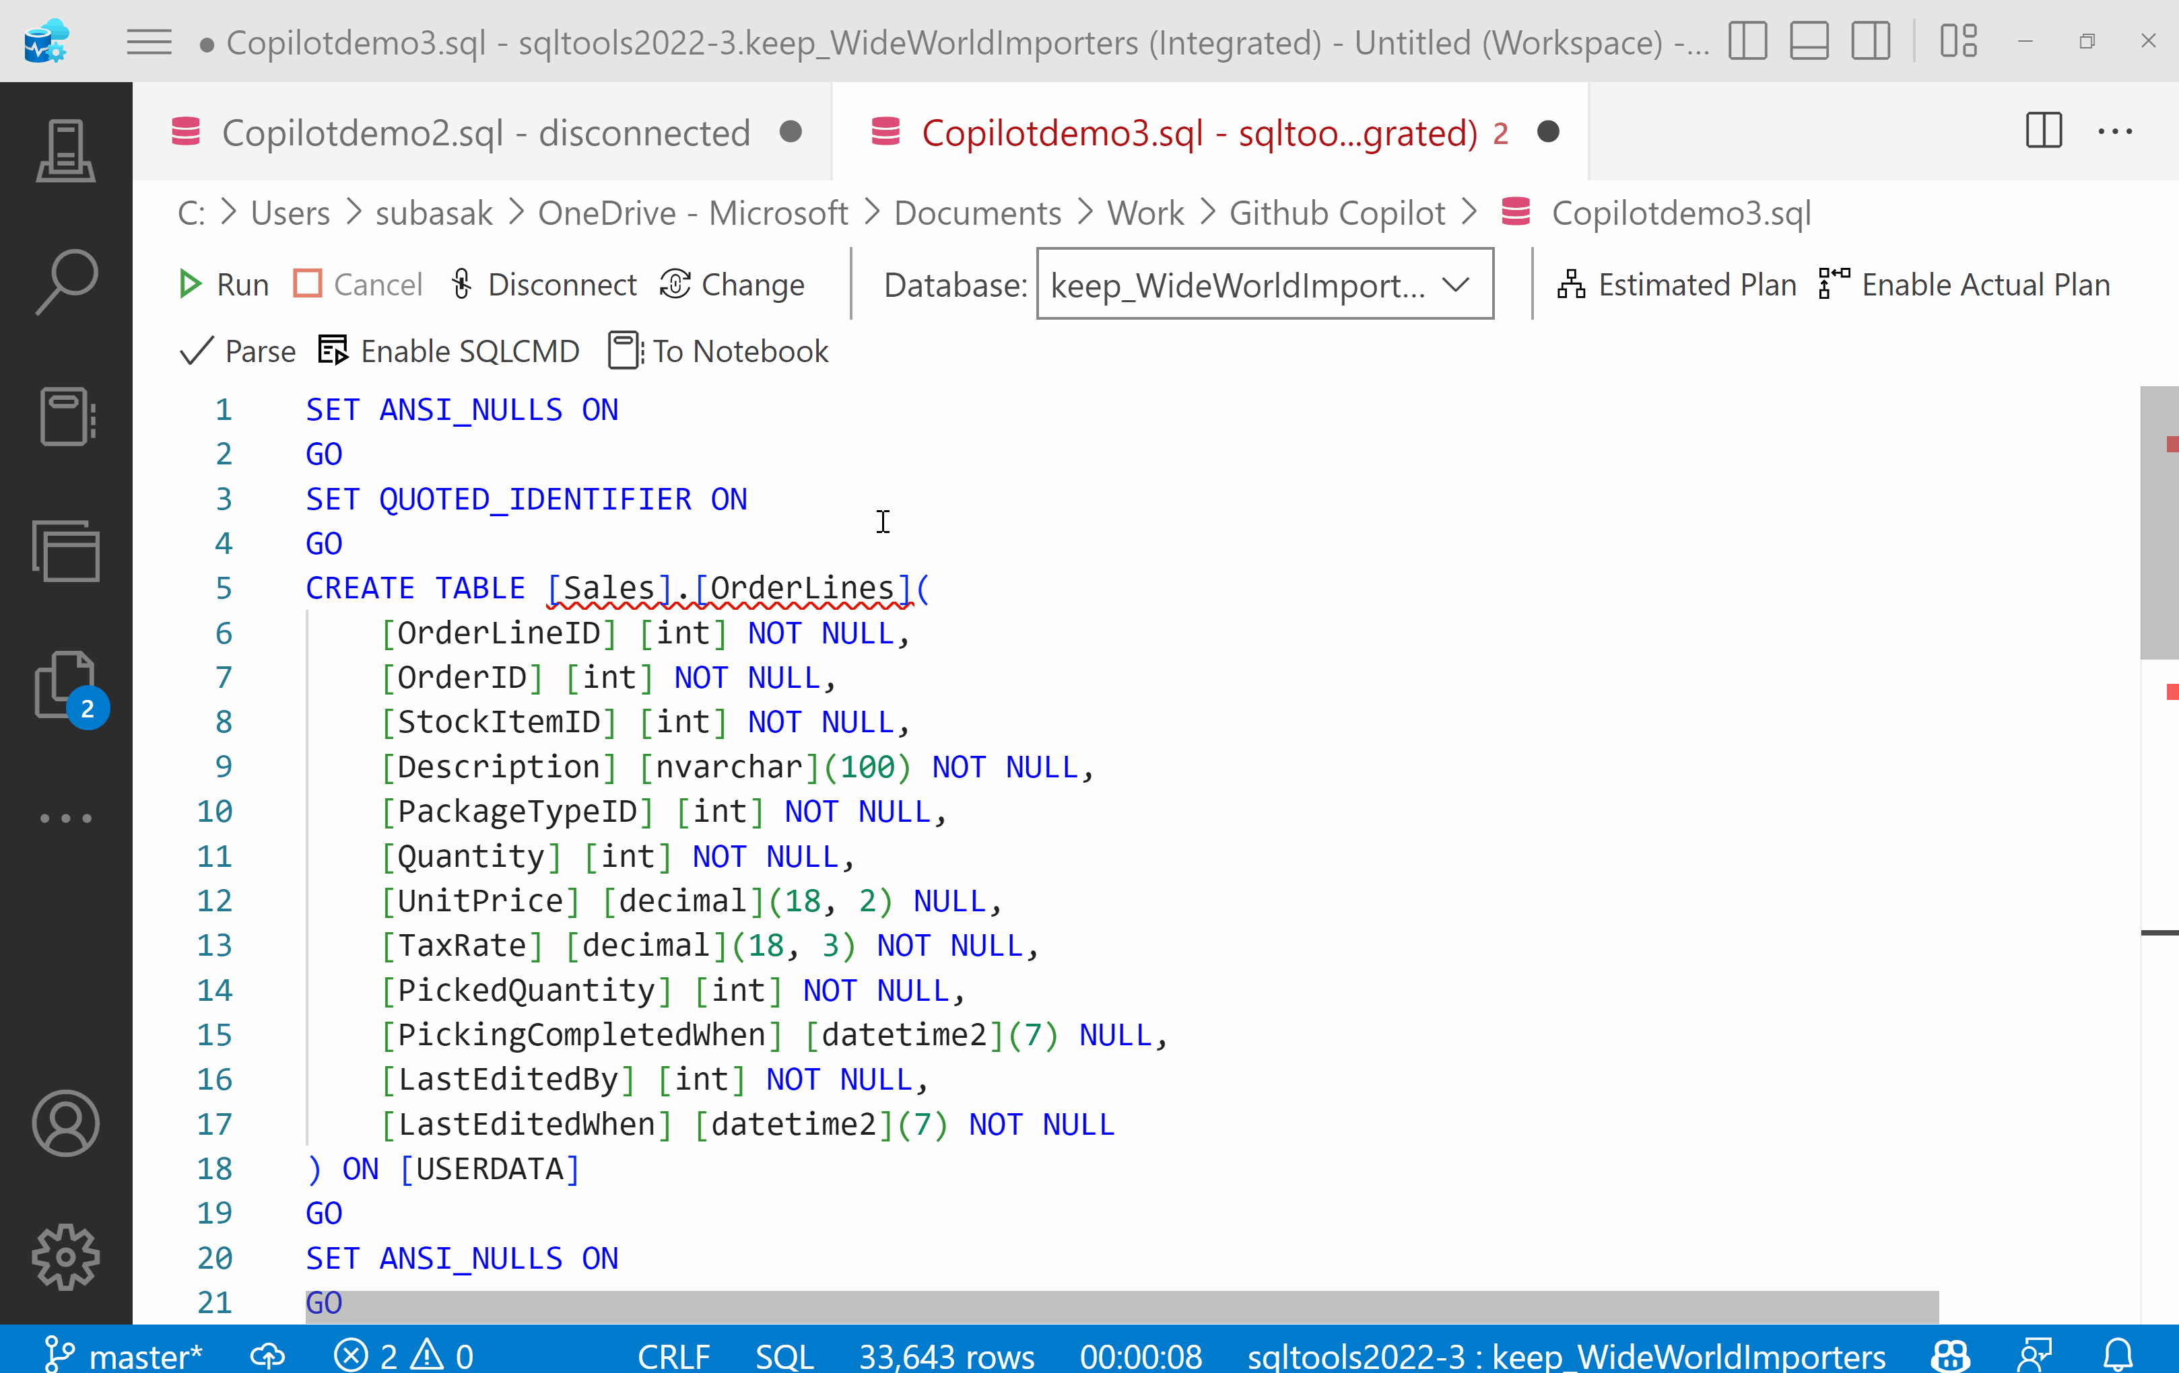

Join with WHERE Clause

Slide 15
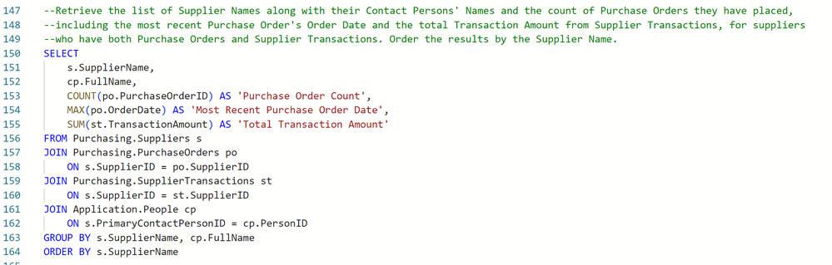
Complex Join

Slide 16
Demo 3: Optimization
Reducing iterations, Removing Table variables, Removing Cursors
Notes:
It’s a good reminder that there are no hard and fast rules about performance tuning. You have to measure your improvements, which means you need a performance baseline. Remember too that baselines aren’t static. Performance changes from hour to hour and day to day over a regular business period.

Slide 17
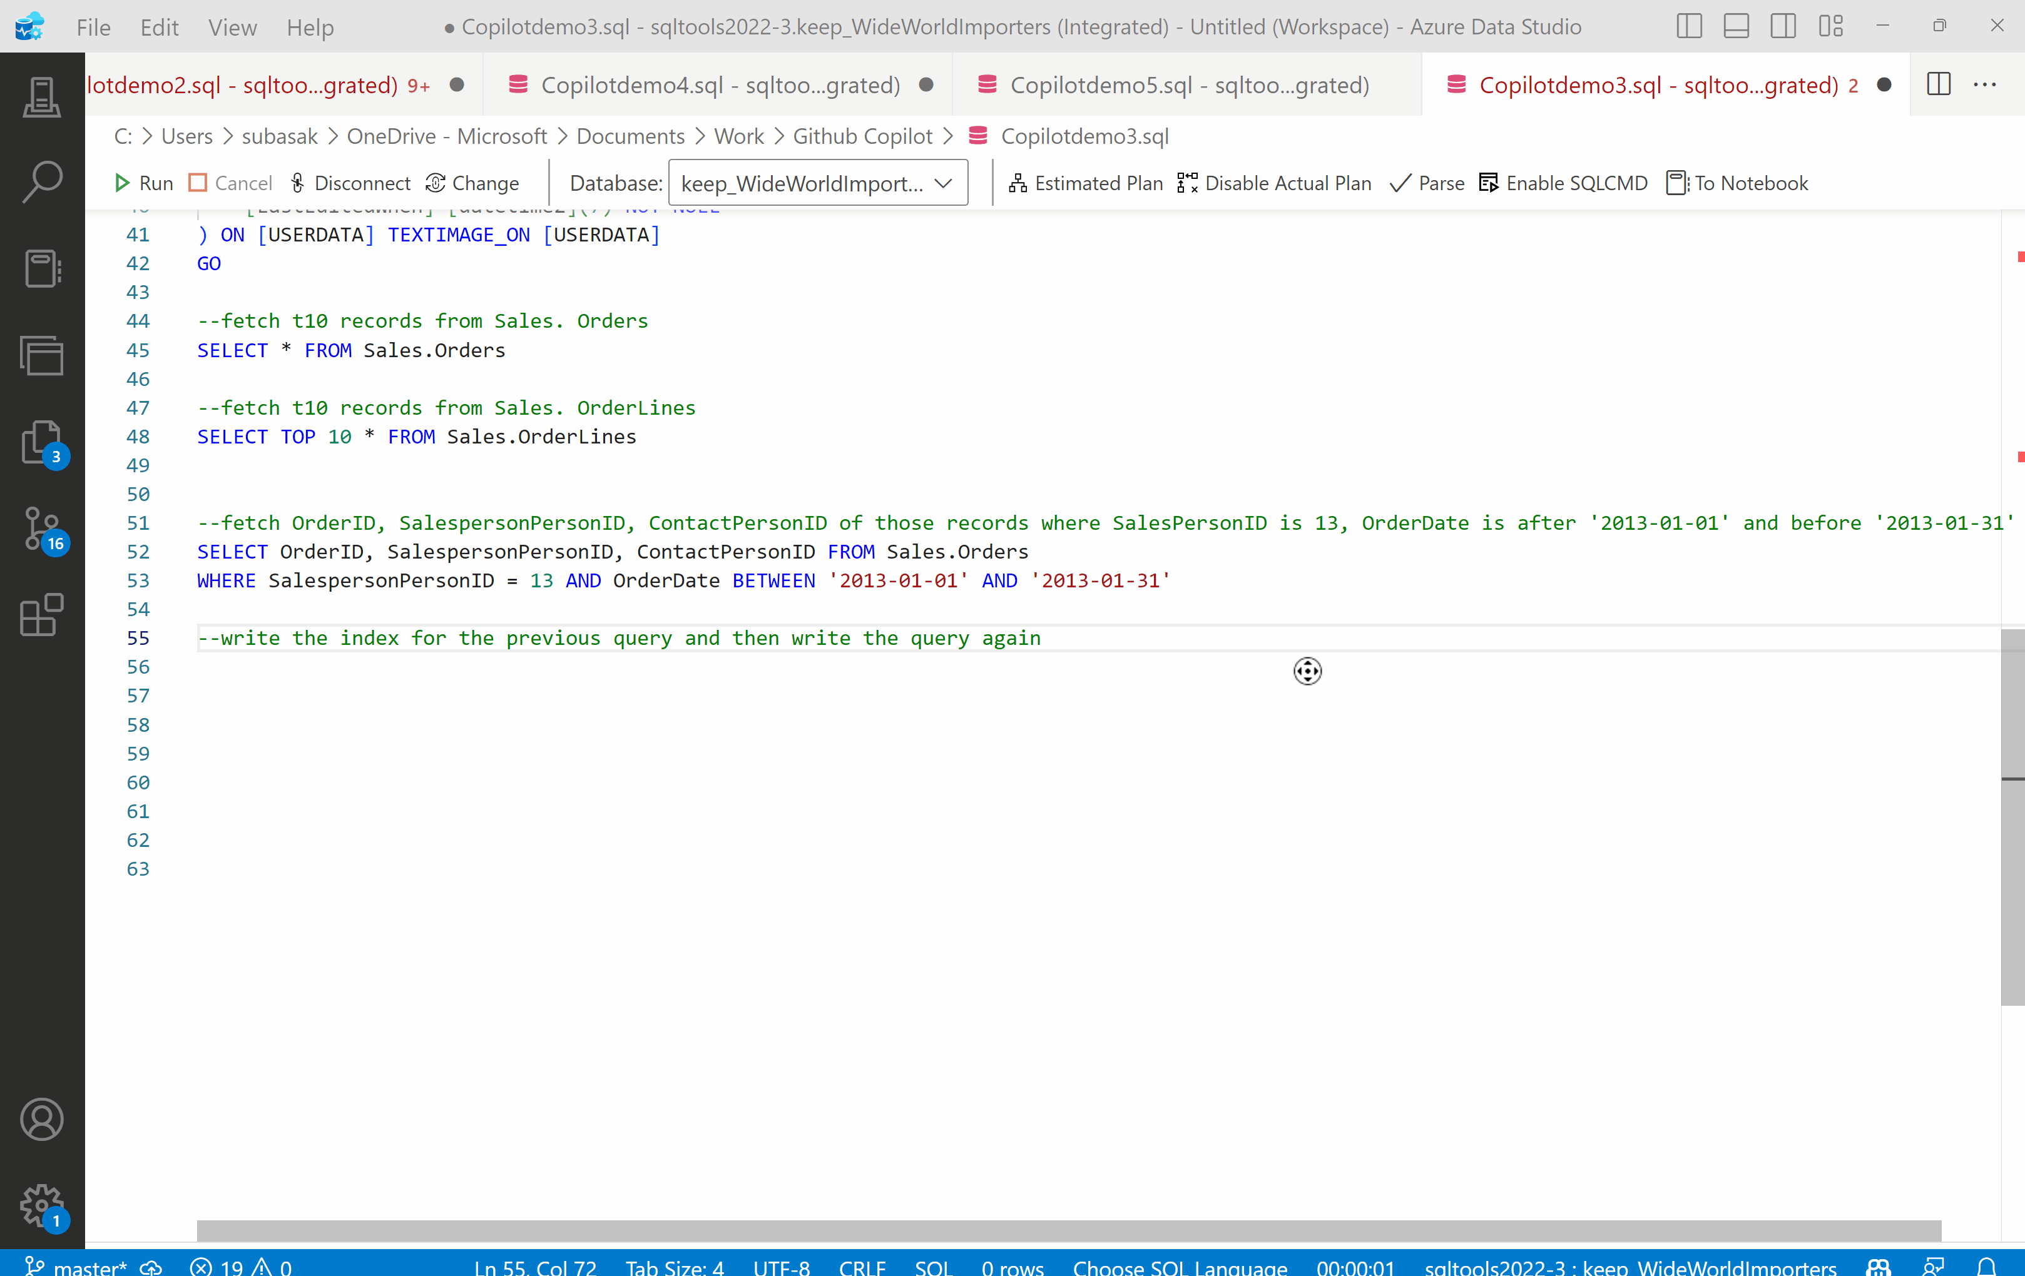
Adding Index
Notes:
The significance of creating this nonclustered index is that it will speed up queries that involve searching or sorting by the SalesPersonID or OrderDate column in the Sales.Orders table. Without an index, such queries might require a full table scan, which can be slow and resource-intensive for large tables. With the index, SQL Server can quickly locate the relevant rows based on the indexed column, resulting in improved query performance.
It's important to note that while indexes can significantly enhance query performance, they also come with some trade-offs. They consume storage space and require maintenance, particularly when the underlying table is updated (inserts, updates, or deletes). Therefore, it's essential to carefully consider the indexing strategy based on the specific usage patterns and requirements of your database.

Slide 18
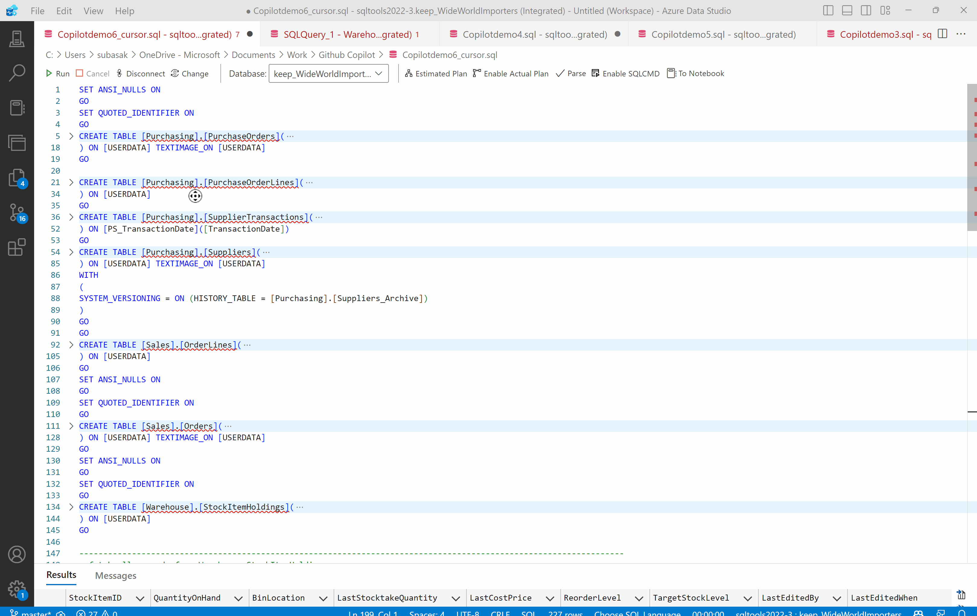
Cursors in SQL
Notes:
The provided SQL code snippet is an example of using a cursor to process data row by row from the Warehouse.StockItemHoldings table, based on a certain condition, and then insert the relevant data into a temporary table (@SalesDetail). Finally, it retrieves aggregated information from the temporary table.
In summary, this code snippet demonstrates the use of a cursor to process rows from one table, insert relevant data into a temporary table, and then perform aggregation on the temporary table to calculate the total quantity and picked quantity for each order line. Cursors are often used when row-by-row processing is required, but they should be used judiciously as they can impact performance, especially for large datasets.
When we ask Copilot to optimize the query, it very intelligently understands the overhead and post optimization retrieves data from the Sales.OrderLines and Sales.Orders tables while filtering based on the condition that the StockItemID must be present in the result set obtained from the subquery. It then performs aggregation on the selected data.

Slide 19

Things to Watch For
We are providing you with a Copilot. Please remember… You are still the Pilot!
Writing prompts for Copilot has its own learning curve
Sometimes, Copilot in the attempt to optimize your query might end up changing the context and generating a different output. Be wary of that.
Notes:
AI is probabilistic and not deterministic. Every demo can be a lil different
Don’t use what you see. Use your brain.
Same prompt giving different answers
See the query returns the same answer

Slide 20
Summary
GitHub Copilot, is your personal coding assistant.
Don’t forget, you are the pilot
Copilot needs to get the context of your database to be able to generate correct prompts. This context can be provided by giving DDL at the beginning.
In multiple scenarios GitHub Copilot can help in optimizing SQL queries and incorporating the best practices of SQL development into query building.
GitHub Copilot doesn’t store your data. Your data rests with you.

Slide 21
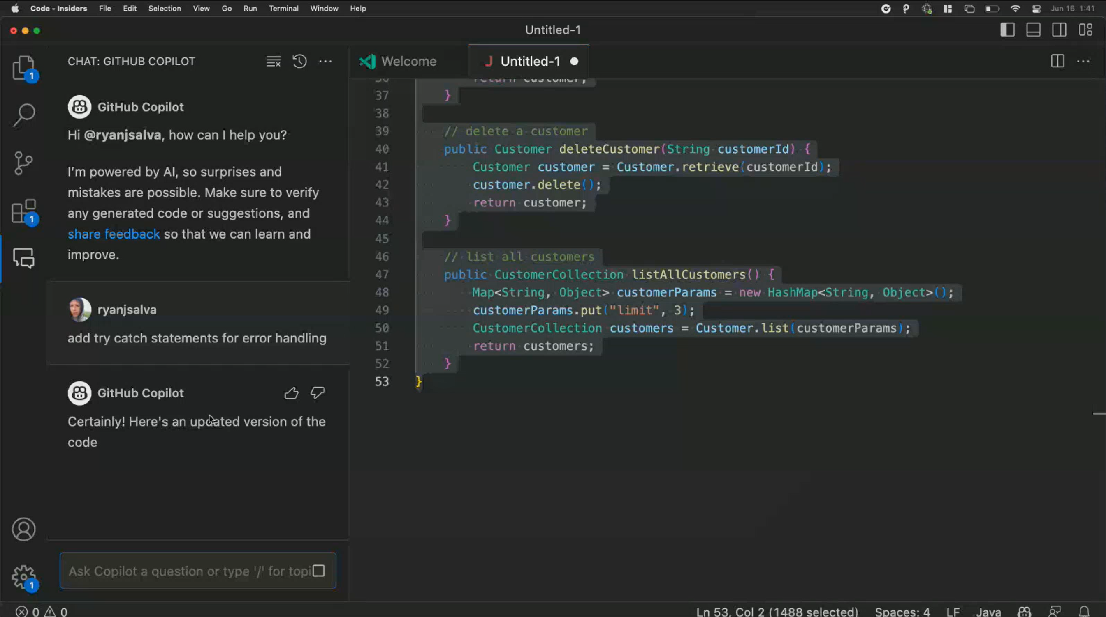
Sneak Peak into the Future

Slide 22
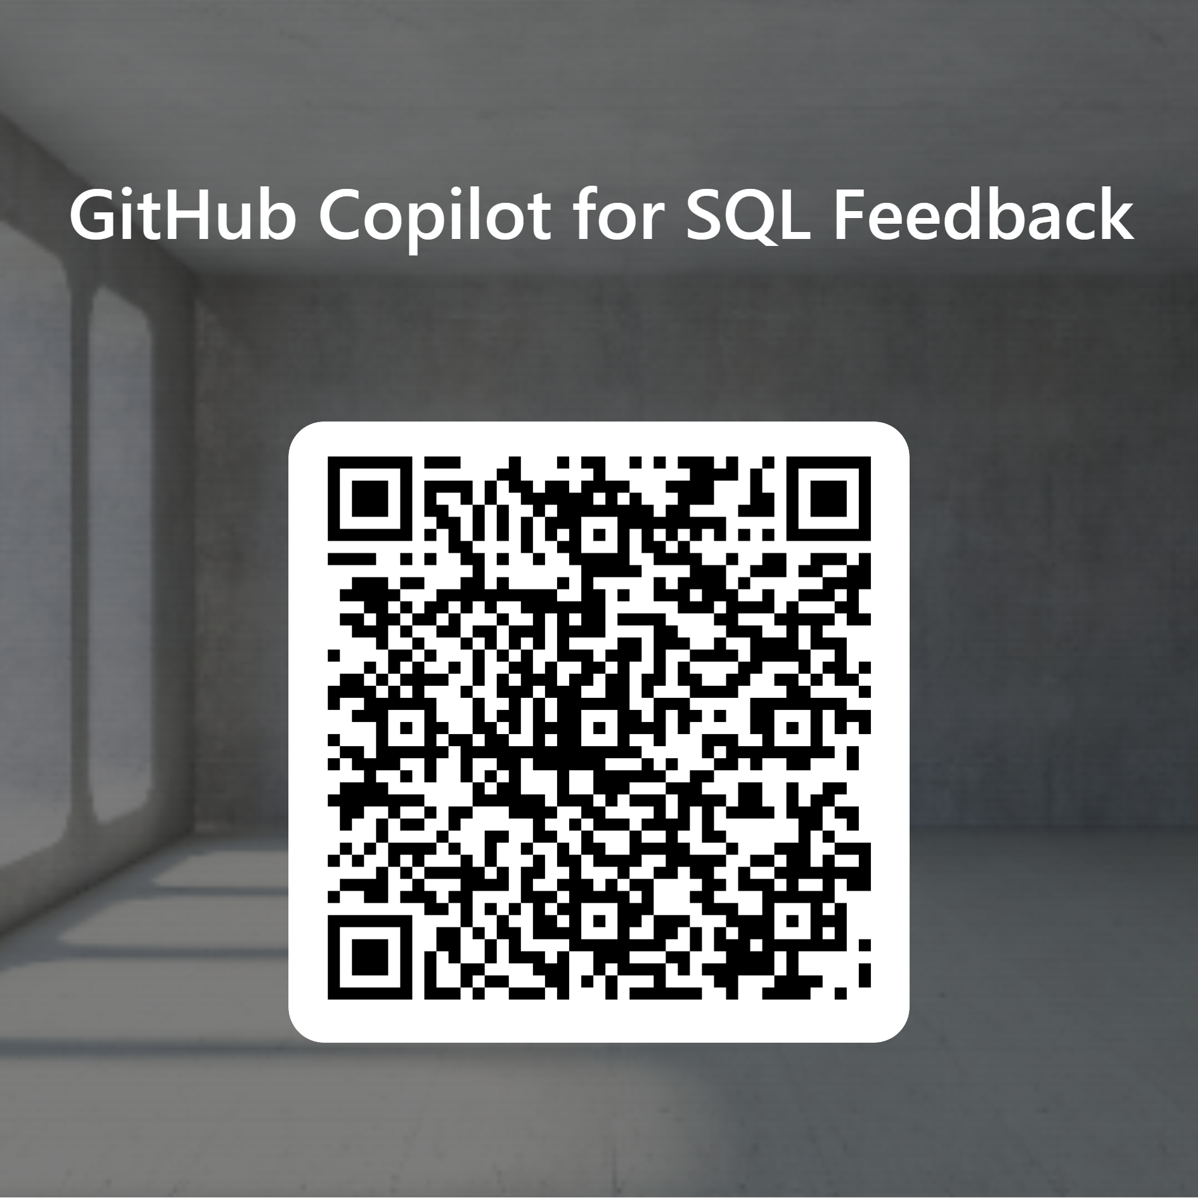
Q & A
GitHub Copilot is continuously improving. We would love to hear feedback from you to make us better.
https://forms.office.com/r/p1K7LTcG2B

Slide 23






THANK YOU
Blog 1
Blog 2
Subhojit Basak
subasak@microsoft.com
www.linkedin.com/in/subhojit-basak
https://twitter.com/subho4594
Blog 3

